Slide 1
Data Incubator
Project analyze FEDERAL Spending
Prathiba Duvvuri
19/02/2019

Slide 2
CONTENTS
GENERAL APPROACH
ANALYSIS

Slide 3
GENERAL Approach
Identify Problem Statement
Collect and Prepare Data
Analyze Data
Interpret Results

Slide 4
Identify Problem Statement
Objective:
Discover USA federal government’s spending accounts across different departments over time
Motivation:
Visualizations bring awareness among general public
Insights will help Federal Government for effective budget management and process optimization

Slide 5
Collect AND PREPARE Data
Data Source:
https://www.usaspending.gov/#/
47 GB Total
Data selected for Analysis on
  Contract spending across departments for year 2019
  Resources vs Obligations for year 2018
Research to be expanded across various departments and over time

Slide 6
ANALYZE Data
Contract spending – 2019 &
Resources vs Obligations for year 2018
Python
    Pandas
    Numpy
    Matplotlib
Applied methods for selecting appropriate columns and rows
Various grouping and aggregation techniques on columns of interest for analysis
Tableau

Slide 7
ANALYZE Data
Contract spending across departments for year 2019
  103 MB
  639480 Rows and 261 Columns
Resources vs Obligations for year 2018
  Combined multiple CSV files across quarters
  0.29 MB
  512 Rows and 18 Columns

Slide 8
ANALYZE Data
Contract spending - 2019
Out of 66 departments, 3 departments accounted for
  92.13 % of total spending dollars
  76.51 % data size
Focused Analysis on top 3 spending departments
  Department of Energy (DOE)
  Department of Defense (DOD)
  National Aeronautics and Space (NASA)

Slide 9
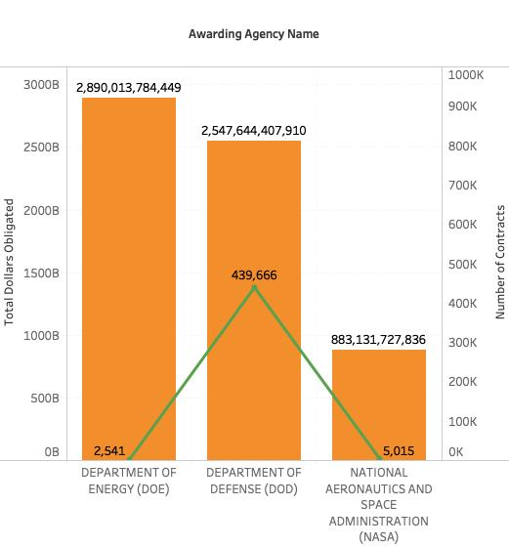
ANALYZE Data
Contract spending - 2019
Department of Energy has highest spending on contracts
Department of Defense has second highest spending on contracts but no. of contracts accounts are relatively high

Slide 10
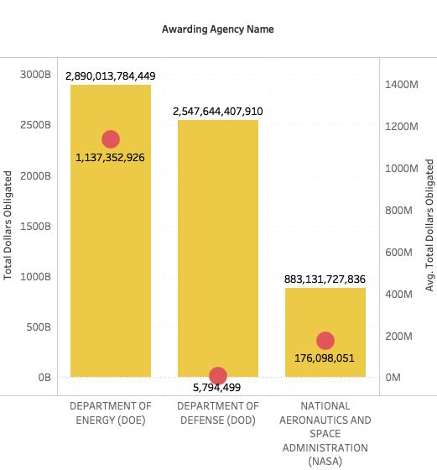
ANALYZE Data
Contract spending - 2019
Comparing total dollar amount vs average amount spent across departments top 3 departments
Average value of contract is relatively less for Department of Defense

Slide 11
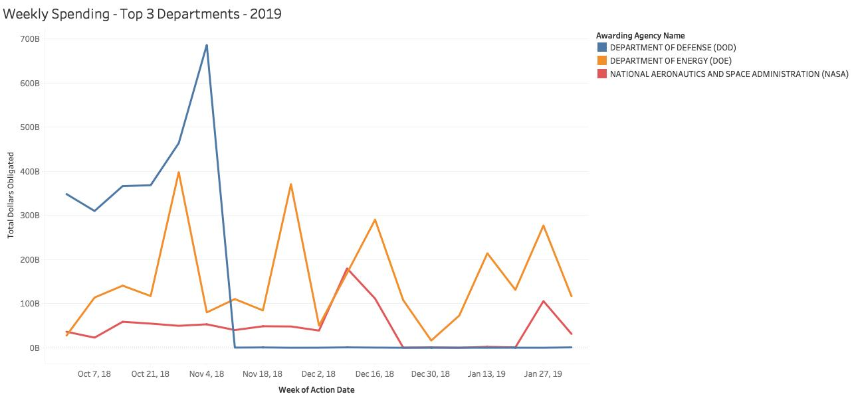
ANALYZE Data
Contract spending - 2019
Observed seasonal trends in contract spending occurring with peaks every month
contract spending spiking near the end of the government’s fiscal year

Slide 12
INTERPRET RESULTS
Contract spending - 2019
Department of Energy has highest spending accounting for 289 Billions followed by Department of Defense and NASA
Of the 3 departments, no. of contracts is very high for Department of Defense accounting for 98.3 %
This shows average value of contract is high for Department of Energy

Slide 13
ANALYZE Data
Resources vs Obligations for year 2018
Selected Judicial Department for analysis on Resources vs obligations
  64 .42 % data size is accounted for top 3 departments
Top 3 departments -
  Treasury
  Justice
  Homeland security

Slide 14
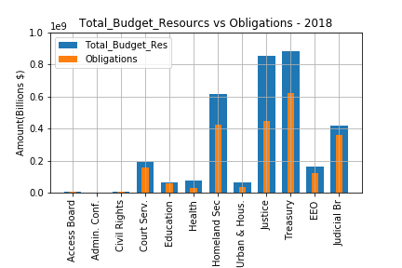
ANALYZE Data
Resources vs Obligations - 2018
Department of Energy has highest spending on contracts
Department of Defense has second highest spending on contracts but no. of contracts accounts are relatively high

Slide 15
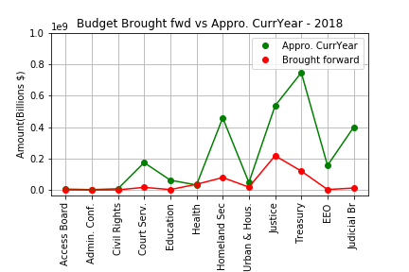
ANALYZE Data
Resources vs Obligations - 2018
For the top 3 departments, both resource allocation from current year as well as brought forward from previous year are relatively high

Slide 16
INTERPRET RESULTS
Resources vs Obligations - 2018
High budget allocation and obligations are found for certain departments like Treasury, Justice, Homeland Security, Judicial Bar compared to other departments
For education, this is just as required. Surplus amount from other departments may be transferred to departments in need, say education
Budgets allocated from current year as well as brought forward from previous year are comparatively high for certain departments

Slide 17
IN PROGRESS
Clustering algorithms in scikit-learn for analyzing more data across years and departments
Analysis to be performed on factors like on what basis budget is being allocated, constraints on project completions etc.,

Slide 18
Thank you

